Slide 1
Static Timing Analysis
Presenter : Min-Feng Hsieh
Adviser : Ting-Chi Wang

Slide 2
What is the purpose of STA?
STA is a way to validate if there is a violation occurrence on timing
When?
After synthesis (logic synthesis)
After scan chain insertion (DFT)
After P&R (APR)
Notes:
通常synthesis只會看setup time violation
Hold time 會在CTS之後看，插buffer

Slide 3
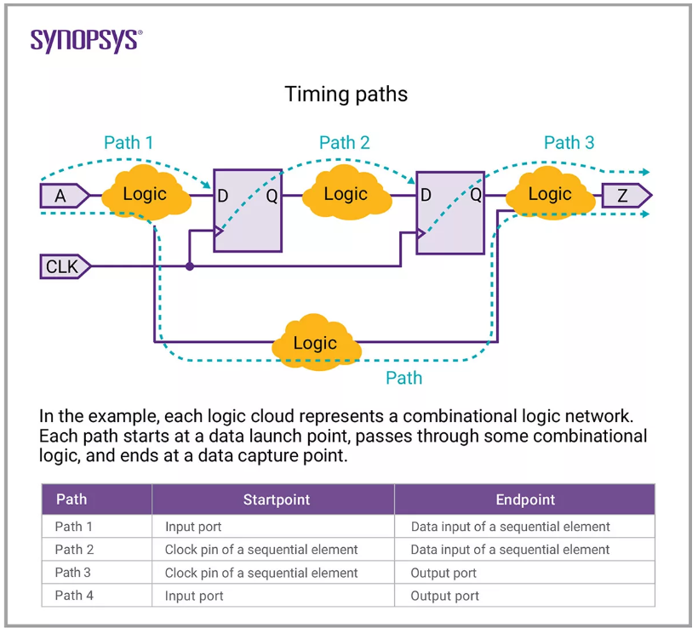
Timing Path
in2reg (Path1) : input to register
reg2reg (Path2) : register to register
reg2out (Path3) : register to output
in2out (Path4) : input to output

Slide 4
Basic timing analysis of STA
Setup time (Tsu) (-delay_type max)
Hold time (Th) (-delay_type min)
Recover time
Removal time

Slide 5
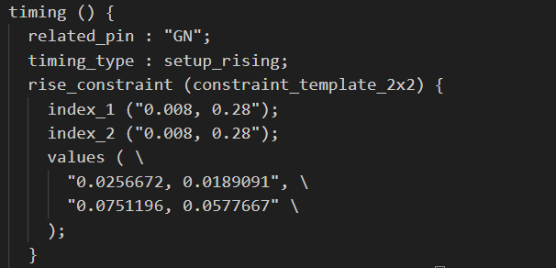
Library

Slide 6
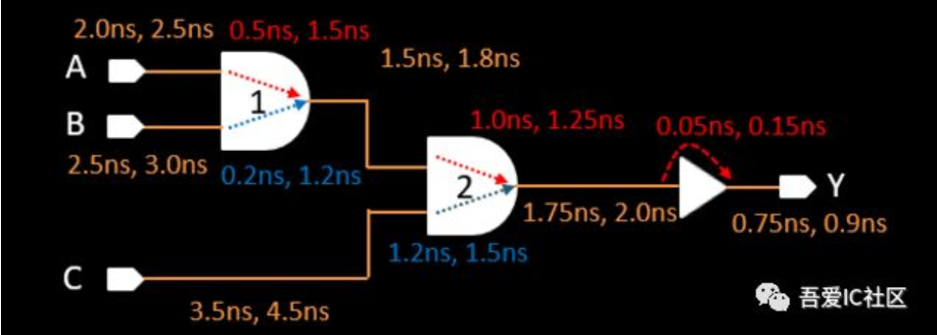
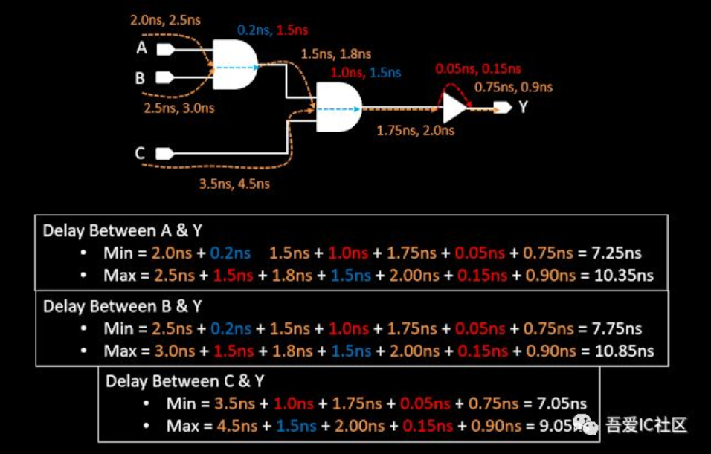
GBA based STA

Slide 7
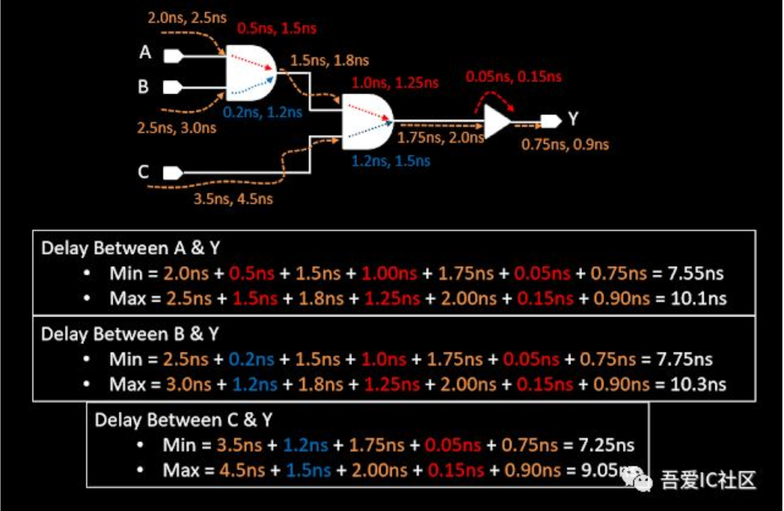
PBA based STA

Slide 8
GBA PBA

Slide 9
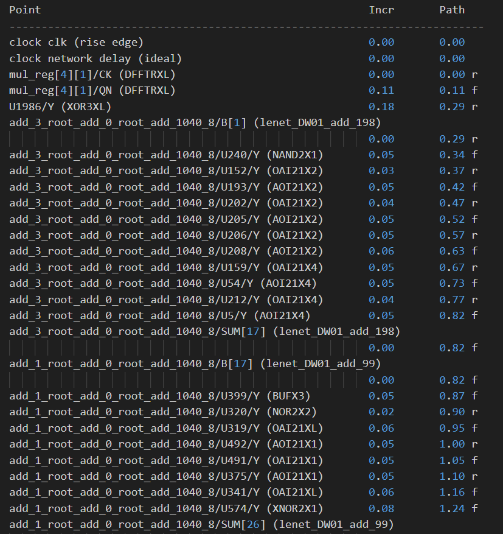
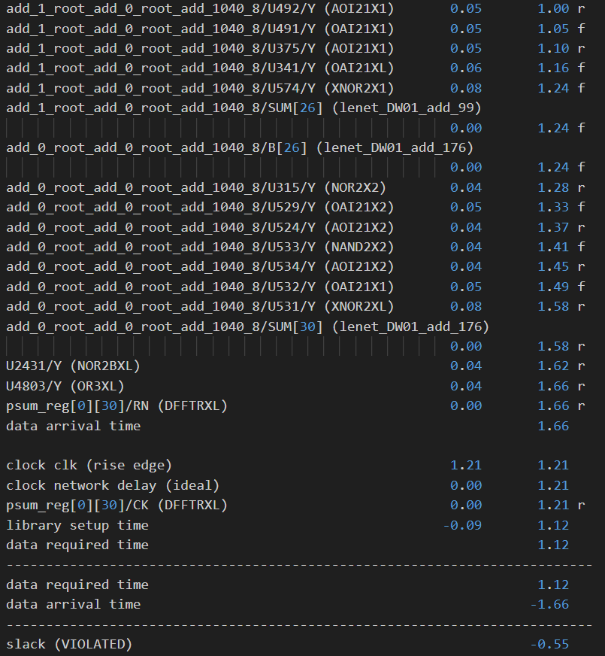

Slide 10
Thank you for listening!

Slide 11
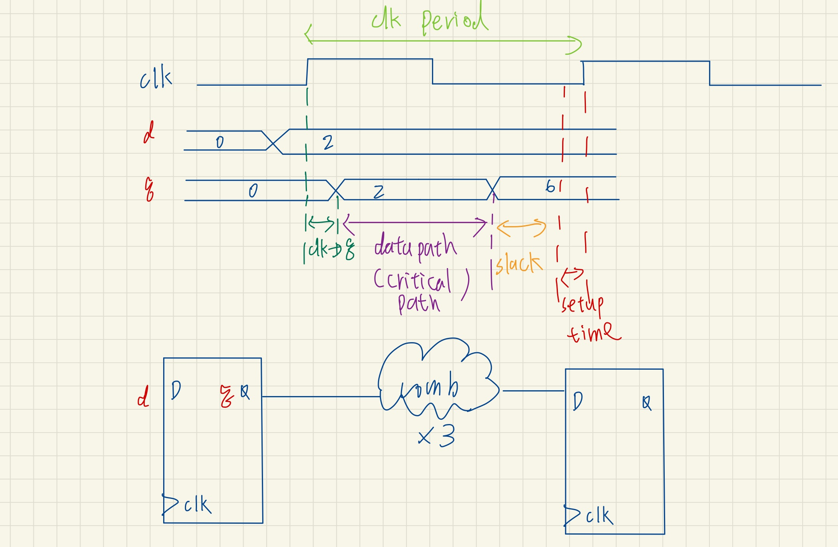
Setup time

Slide 12
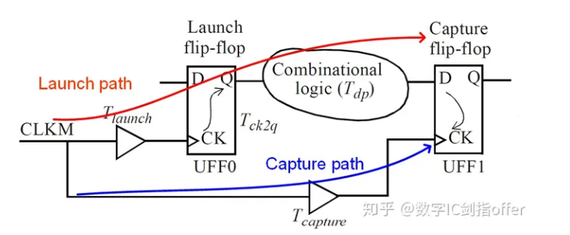
Tlaunch path = Tlaunch + Tck2Q + Tdp (arrival time)
Tcapture path = Tcapture + Tclk - Tsetup (required time)
Tcapture path - Tlaunch path = slack >= 0
Tclk + Tskew >= T ck2Q + T dp + T setup + slack

Slide 13
Hold time
Tlaunch path = Tlaunch + Tck2Q + Tdp (required time)
Tcapture path = Tcapture + Thold (arrival time)
Tlaunch path - Tcapture path = slack >= 0
Tck2Q + Tdp >= T hold + Tskew

Slide 14
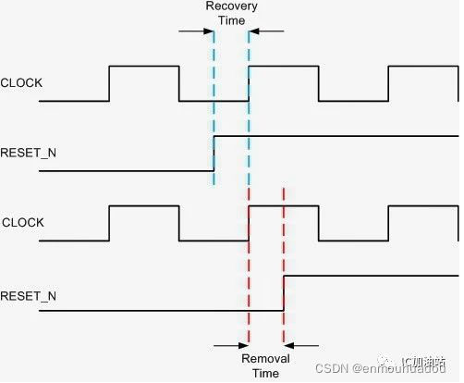
Recovery time, Removal time

Slide 15
Recovery time, Removal time
Synchronized reset:
After synthesis, the reset is included in the datapath
Will be ruled by the timing constraints
Asynchronized reset:
Can avoid some combinational delay
May cause metastable

